Slide 1

PERFORMANCE ANALYTICS
platform
Christophe Castan
May 2017
The new platform

Slide 2
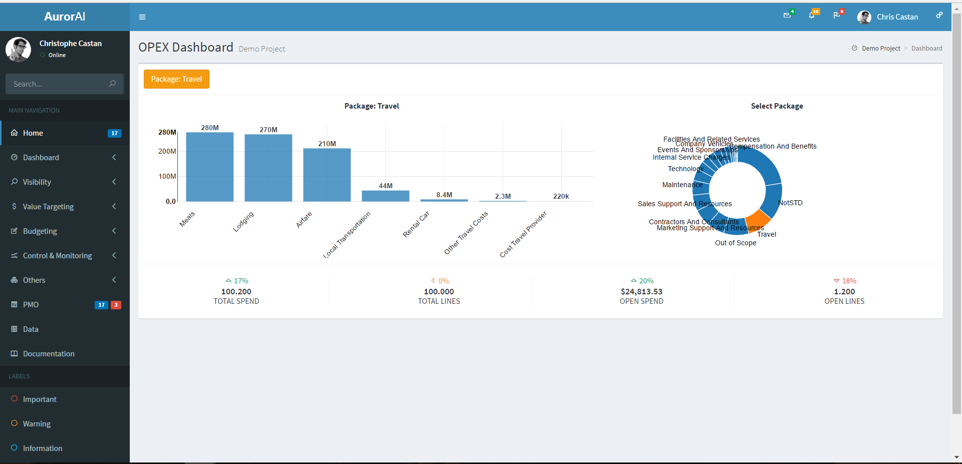
OPEX Dashboard
Filters
Visibility
View Current Visibility + Confidence
+Actions (10 transactions to be reviewed)
Value Targeting
View current Q per package, ambition, and money to still be capture
+Actions (review travel compliance)
Budgeting
View Current Budget vs Latest Estimates
Control & Monitor
View your performance against peers

Slide 3
Visibility (opex) Dashboard
Confidence
History
Current Confidence
Improve Confidence
Filters
Package View
Sub Package View

